Slide 1

Dr. Poudevigne
Risk Management

Slide 2
Objectives
Define risk and risk management
Outline key risk issues and types of risk
Identify concrete methods for minimizing risk

Slide 3
What is Risk?
An uncertainty or chance of loss, usually accidental loss, which is sudden, unusual, or unforeseen (van der Smissen, 1990)
“Dangers that we seek to actively identify, confront and control” (Giddons, 1998, p. 23)
“The probability that a hazard will lead to a loss” (Griffith, 2011, p. 1)
  Apply to any component of the facility or event that could engender a loss or negative outcome
  Implies varying degrees to both hazards and losses

Slide 4
Types of Risk
Four broad categories of risk
  Public liability caused by negligence
1. Failure to provide a reasonably safe environment
  Public liability excluding negligence
2. Individuals are affected by the practices of the personnel within the facility
  Business operations
3. Business interruptions, property loss, contractual issues, or employee health
  Property exposures
4. Natural disasters, fire, vandalism/terrorism, and theft

Slide 5
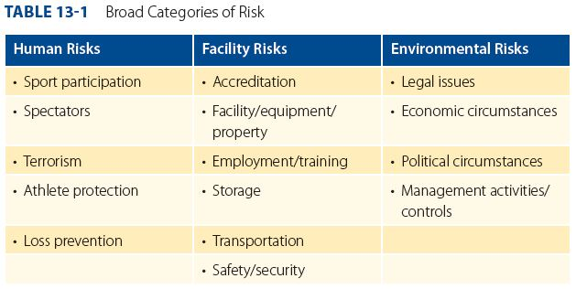
Types of Risk (cont.)

Slide 6
Terrorism and Sport
168 sport-related terrorist attacks in the world between 1972 and 2004
Major events
  Munich 1972
  Atlanta 1996
  Boston Marathon 2013
  Explosion close to the Stade de France 2015
Changes to prevent terrorism
  Bag searches
  Metal detectors
  Disallow admittance of certain objects
  Surveillance equipment
  Read the NFL Teams to enhance public safety and improve stadium access for fans article. It can be found in this weeks folder

Slide 7
What is Risk Management?
“Systematically identifying threats (risks) to your organization and developing ways to minimize them from occurring” (Office of Sport and Recreation, 2009, p. 2-1).
“Provides a framework for determining an individual company’s response to risk, including who would undertake the work involved at a tactical level” (Taylor & Booty, 2006, p. 232).

Slide 8
What are the Benefits of Good Risk Management?
Reduce the likelihood of undesirable and costly impacts
Increase the safety of the patrons
Improve financial issues more generally
Reduce costs associated with insurance premiums
Improve the quality of the sporting experience
Enhance the managers’, employees’, and volunteers’ level of confidence in their abilities

Slide 9
Steps in the Risk Management Process
Risk identification
  Evaluate the environment, structures, and marketplace to determine the sources of risk
  Audit: A systematic critical examination of the facility or event to identify key risk or safety issues
Risk analysis
  Categorize the levels of risks
    How likely is the risk to occur?
    What are the consequences associated with the risk?

Slide 10
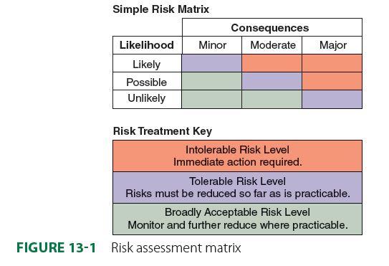
Steps in the Risk Management Process (cont.)
Risk analysis
  Categorize the levels of risks
    How likely is the risk to occur?
    What are the consequences associated with the risk?

Slide 11
Steps in the Risk Management Process (cont.)
Risk evaluation
  Determine whether or not the risk is acceptable
    Cost-benefit analysis

Slide 12
Steps in the Risk Management Process (cont.)
Risk treatment
  Five common strategies
  Avoidance: Discontinue the component of the activity considered as a risk
  Risk retention: Prepare for the risk through budgeting, deductibles, or self-insurance

Slide 13
Steps in the Risk Management Process (cont.)
Risk treatment
  Five common strategies
  3. Reduce the risk: Establishing a series of controls in order to reduce either the likelihood of occurrence or the consequences associated with the risk
  4. Transferring the risk: Moving the risk to another entity (e.g., waiver, insurance)
  5. Retain the risk: Does not employ any of the strategies listed here

Slide 14
Steps in the Risk Management Process (cont.)
Risk monitoring
  A continuous assessment of the risk associated with hosting the event, as well as the management strategies to reduce the risks.
  Monitor the activities associated with the various risks they have identified such as the communication of risk, the occurrence of risk, and the overall response to the risks.
  Tracking the performance of and evaluating your risk management plan will allow for better training of employees, identify gaps within your SOP, and assist in the development of proper reporting systems.

Slide 15
Steps in the Risk Management Process (cont.)
Risk monitoring
  Common monitoring strategies at the evaluation stage of the event include:
    Updating documentation of and the risk management plan as necessary
    Review the occurrences of incidents and the consequences associated with them

Slide 16
Steps in the Risk Management Process (cont.)
Risk monitoring
  Common monitoring strategies at the evaluation stage of the event include:
    Review unexpected occurrences and develop a plan to mitigate or manage them in the future
    Gather information from managers, employees, and volunteers to determine any other risk management issues

Slide 17
Assignment
Identify potential risks that may occur at your event
Categorize each risk
Complete a simple risk assessment for each of the risks

